Slide 1


Fundamentals of JavaScript
Internet Programming I: Lab VII
Addis Ababa Science and Technology University
Department of Software Engineering

Slide 2
Purpose of This Lab
The purpose of this lab is to:
Practice with fundamentals of JavaScript
Add features into your course project
Before this Lab !!
Be familiar with HTML basics
Refer https://www.w3resource.com for these and other more excercises

Slide 3
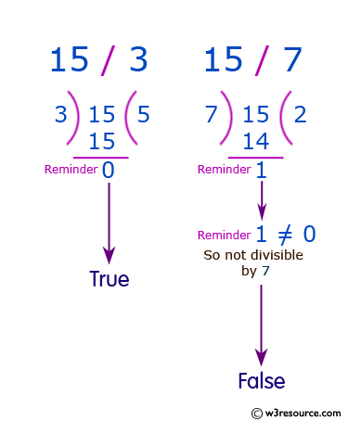
Exercise 1
Write a JavaScript program to check whether a given positive number is a multiple of 3 or a multiple of 7.

Slide 4
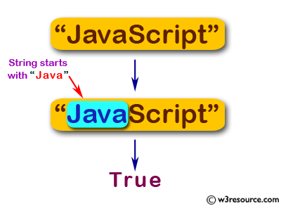
Exercise 2
Write a JavaScript program to check whether a string starts with 'Java' and false otherwise

Slide 5
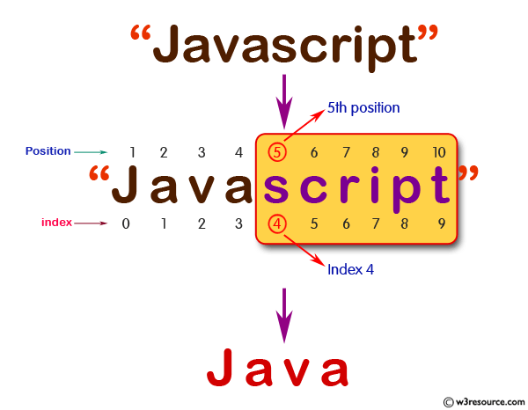
Exercise 3
Write a JavaScript program to check whether a string "Script" presents at 5th (index 4) position in a given string, if "Script" presents in the string return the string without "Script" otherwise return the original one.

Slide 6
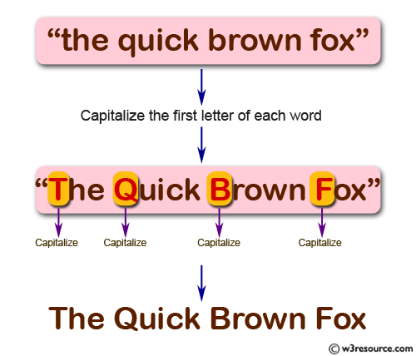
Exercise 4
Write a JavaScript program to capitalize the first letter of each word of a given string.

Slide 7
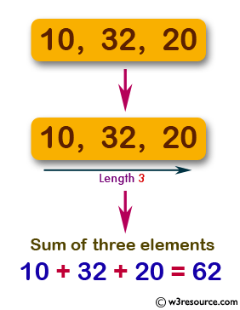
Exercise 5
Write a JavaScript program to compute the sum of three elements of a given array of integers of length 3.

Slide 8
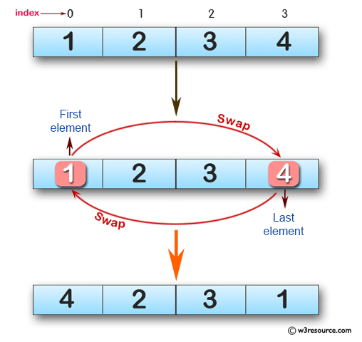
Exercise 6
Write a JavaScript program to swap the first and last elements of a given array of integers. The array length should be at least 1.

Slide 9
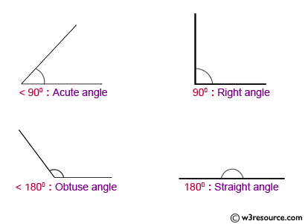
Exercise 7
Write a JavaScript program to find the types of a given angle.
Types of angles:
Acute angle: An angle between 0 and 90 degrees.
Right angle: An 90 degree angle.
Obtuse angle: An angle between 90 and 180 degrees.
Straight angle: A 180 degree angle.

Slide 10
Exercise 8
Write a JavaScript program to create the dot products of two given 3D vectors.
Note: The dot product is the sum of the products of the corresponding entries of the two sequences of numbers.

Slide 11
Working on Your Project
Apply everything you know on your course project

